Slide 1

Case Study Group 8:
Office Supplies Orders case study

Slide 2

Business Objective, Understanding and Approach
Business Objective
The leadership team of a Company with a business nature as online order of furniture is willing to know the performance across different markets and in need of various strategies to boost it’s future sales and Profits.
Understanding Approach
The approach that solves the business problem starts with the data collection and Quality check, followed by detecting the patterns in the data with the help of data visualization and EDD development.
The analysis of data is to be processed by the functions and methods offered by various modules of python. The key steps are taken in the view of analysis of dataset that helps us to recommend the proceeding steps for the benefits and profits of the company.
The Business Problem focuses on the incrementation of Company profits, Company is supplier of furniture globally in various clusters of markets and in moto of finding the strategies to improve its profits.
The company is a supplier of furniture with a business nature of online mode and supply to customers of different types. The types are categorized into Corporate, Consumer, Home-Office.

Slide 3
Analysis/ Modeling Methodology
Data Preparation & EDA
Data Quality check
1. The dataset of “Office suppliers orders” consists of 23 variables and 15 of them are object data type.
All of the variables get read in python in the right format.
2. The Postal Code is the only variable of datatype float which has missing values and percentage of
missing values is 81. As the missing value percentage is maximum and it does not effect the outcomes the Postal Code column is dropped from the data set.
3. The dataset do not have columns having duplicate values as entries.
Outliers
The data set has outliers for variables as sales ,Quantity ,Discount ,Profit , Shipping cost.
More than 50% of discount is offered rarely to the products.
Very less customers are choosing the quantity of the product more than 9.
The sales value crossing 5000 is not noticed in the past dealings of company.
On the bases of outliers, the companies indulges very less shipping cost on the supplied products.
The maximum of profit values lies in between -2000 to 2000 and According to data the loss percentage is more.

Slide 4
Extended Data Dictionary (EDD)
Variable name | Variable Type | min | Pc 1% | Pc 5% | Pc 25% | Pc 50% | Mean | Pc 75% | Pc 95% | Pc 99% | Max | % Missing values | %unique values
Sales | Float64 | 0.44 | 3.6 | 8.80 | 30.75 | 85.05 | 246.49 | 251.05 | 1015.9 | 2301 | 22387.4 | 0 | 53.03
Quantity | Int64 | 1.0 | 1.0 | 1.0 | 2.0 | 3.0 | 3.47 | 5.0 | 8.0 | 11.0 | 14.0 | 0 | 0.2
Discount | Float64 | 0.0 | 0.0 | 0.0 | 0.0 | 0.0 | 0.14 | 0.2 | 0.6 | 0.7 | 0.85 | 0 | 0.5
Profit | Float64 | -6599.9 | -351.5 | -83.9 | 0.0 | 9.24 | 28.61 | 36.81 | 211.5 | 587.3 | 8399.9 | 0 | 55.04
Shipping Cost | Float64 | 1.00 | 1.11 | 1.32 | 2.61 | 7.79 | 26.47 | 24.45 | 111.40 | 286.75 | 933.57 | 0 | 32.6
Findings from EDD
Even though Sales of the company is at high values there is no equivalent profit is observed.
The missing value percentage implies the best quality of dataset. The company offers fewer discounts on the products supplied.
The maximum shipping cost of product proposed by company is around 940.
Most of the visited customers prefer the quantity in less value and this effects the sales and returns in negative profits.

Slide 5
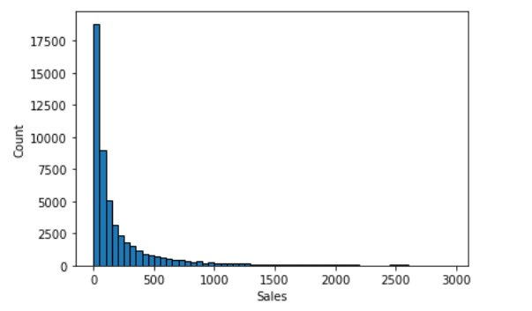
Analysis Results
Univariate distribution on Numerical Variables
The univariant distribution of numerical variables results in a high specific findings.
The Sales factor effects the profits of the company most when compared to the other numerical variables.
The distributions and patterns of variable is observed and
Analysed for the future recommendations.
Key Findings
The sales rate of the products majorly lies up to 1000 and later the sales count is decreased and after that we find a decline in sales which lead into a major losses.
Profit measures of company mostly lead in a negative values
The discount is offered less than 50% and even 0% for most of the products which never attract the customers.
The customers order chooses the Quantity 2, The sales are high with the defined Quantity and there are rare conditions where the quantity has high value and this leads to less profits.
The shipping cost issued is not more than 40/- in most of the orders, supplied by the company to different markets and this attracts the users.

Slide 6
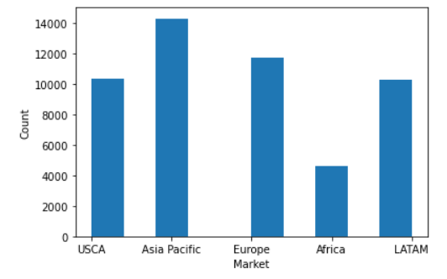
Univariate distribution on Categorical Variable – Market
The Asia Pacific has high market when compared to all other markets.
Africa has low market among all the markets that the company possess.
As the market is more sales are more in Asia pacific and sales are less in Africa market .
Sales doesn’t have any effect on profit . Even though sales are high there are no heavy profits in the markets.

Slide 7
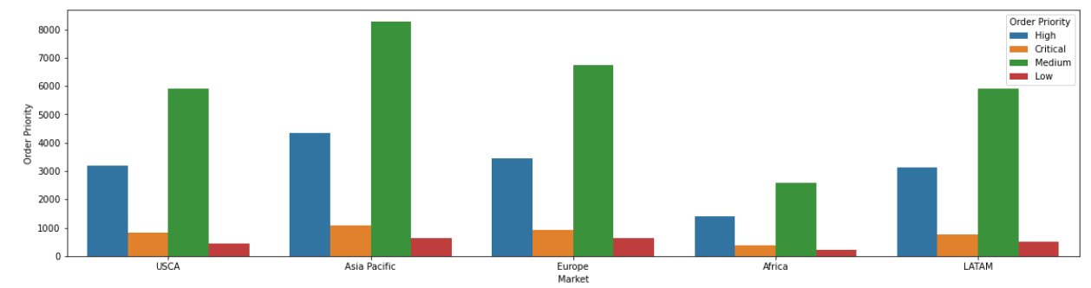
Bi-Variate Distributions
Count Plot on relevant Numerical Variables
𝐵𝑦 𝑆𝑒𝑒𝑖𝑛𝑔 𝑇ℎ𝑒 𝐴𝑏𝑜𝑣𝑒 𝑃𝑙𝑜𝑡,𝐴𝑠𝑖𝑎-𝑃𝑎𝑐𝑖𝑓𝑖𝑐 𝐶𝑜𝑛𝑡𝑟𝑖𝑏𝑢𝑡𝑒𝑠 𝑀𝑜𝑟𝑒 𝑁𝑢𝑚𝑏𝑒𝑟 𝑂𝑓 𝑂𝑟𝑑𝑒𝑟𝑠.
𝐴𝑓𝑟𝑖𝑐𝑎 𝐶𝑜𝑛𝑡𝑎𝑖𝑛𝑠 𝑉𝑒𝑟𝑦 𝐹𝑒𝑤 𝑂𝑟𝑑𝑒𝑟𝑠.

Slide 8
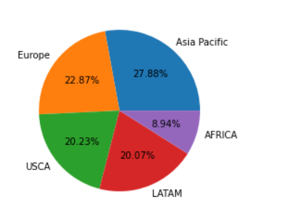
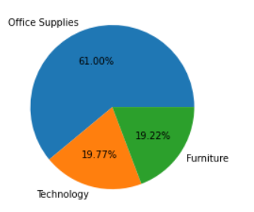
Visual distribution of Object Variables
Key Findings
The market is held in 5 regions.
The major part of market is in Asia Pacific with 27.88 percentage.
The company shares a minor part in Africa as it has only 8.94 percentage
The analysis results a major finding that the customers located in USCA area are more attracted towards the products and major sales held in this country.
Key Findings
The Category of products supplied by the company is categorized into Office Supplies, Furniture, and Technology
The major orders for the company falls in the office supplies category.
The company shares a less part of orders in furniture category.

Slide 9
Analysis Outcomes & Recommendations
All the 17415 customers who are approaching the company are willing to buy only within 3378 products.
Out of 51290 customers 33.9% customers gave single order while 66.1% customers gave repeated orders.
The price of the fasteners and tables is high and more discount is given on tables.
Even though more discount is given on tables the quantity they are being sold is very less.
Moreover , loss is experienced by the company due to high discount on tables.
The company is experiencing more profit by selling Copiers even though they are sold in average quantity.
Even though Phones has more shipping cost the profit they are experiencing on phones is high.
More people are interested to buy the products related to technology in all of the five markets.
The Customers from Asia pacific and latam give preference to buy products related to furniture along with products related to technology.
The mode of shipping has no effect on the Profit of the product and the quantity sold.
Most of the Customers are preferring Standard Class.
Time taken to ship a product has no effect on profit.

Slide 10
Key Takeaways and Recommendations
Key Takeaways from the Analysis
The company has more loss when compared to profit.
The company is experiencing more loss even though it is giving low discount.
More customers are willing to buy only less quantity of a product.
Final Recommendations :
The Company has less market in LATAM . So, increase the customers from LATAM by offering special offers on high demanded products.
Try to increase the discount without getting loss.
As there is a low rate of customers preferring high quantity goods, there is a need to provide offers on high Quantity purchases for the benefits of the company.
In majority of the demanded products comes under office supplies so there is a need to maintain a high quantity of products.

Slide 11
Recommendations
Focus on the customers who place order only once and take reviews from the customers and approach the customers who placed customers only once.
The customers who placed repeated orders must be offered more which attracts the other customers for placing the orders.
If shipping cost is less there is a possibility to increase the sales.
Increase the quality of the products and do focus on the supplying the finest products.
Don’t give too much discount or too low discount. The discount that we offer should never lead us to losses.
As there is a low rate of customers preferring high quantity goods, there is a need to provide offers on high Quantity purchases for the benefits of the company.
Optimize the website speed and make it user friendly and increase the readability and develop interactive interface.
Try to provide combo products and focus on the product patterns.
Focus on product reviews and replacing the best products and Offer a trustable money back guarantee.

Slide 12
Summary
Approach & Solution
Insights/ Recommendations
The approach that solves the business problem starts with the data collection and Quality check, followed by detecting the patterns in the data with the help of data visualization and EDD development.
The analysis of data is to be processed by the functions and methods offered by various modules of python. The key steps are taken in the view of analysis of dataset that helps us to recommend the proceeding steps for the benefits and profits of the company.
We found the major patterns and came across some scenarios for the solution of issues.
Focus on the customers who place order only once and take reviews from the customers and approach the customers who placed customers only once.
The customers who placed repeated orders must be offered more which attracts the other customers for placing the orders.
If shipping cost is less there is a possibility to increase the sales.
Increase the quality of the products and do focus on the supplying the finest products.

Slide 13

TEAM DECODERS

